Slide 1

Overcoming HPC System Management Challenges: An Open Source Approach
Michael Hartman (michael.hartman@stanford.edu )
- Stanford Research Computing Center (SRCC)
Stéphane Thiell (sthiell@stanford.edu )
- Stanford Research Computing Center (SRCC)
Kilian Cavalotti (kilian@stanford.edu )
- Stanford Research Computing Center (SRCC)
STANFORD RESEARCH COMPUTING CENTER
Notes:
Sherlock
Stanford's main HPC cluster
Condo model
Currently consists of 1483 nodes and 96 IB switches
Go over some of the challenges we have run into at Stanford and share the open source tools that were developed to deal with those challenges

Slide 2
Outline
Fir/Oak File Systems
sasutils
Oak Storage Lifecycle
del_ost
ibswinfo
Slurm SPANK GPU Plugin

Slide 3
Lustre storage systems
Fir
Sherlock’s scratch filesystem
High-performance storage system for temporary data
4 MDTs, 96 OSTs, 960 hard drives in 8 I/O cells, 6 PB usable
Oak
Global, capacity-oriented Lustre filesystem
6 MDTs, 462 OSTs, 4,704 hard drives in 7 I/O cells, 52 PB usable total
Notes:
Fir
- used for primarily for running jobs
- not designed for long term storage ( files purged after 90 days )
- migrating to Flash for greater speed and iops
Oak
Stats are after the addition of I/O cell 8
longer-term storage for large research data sets,
mounted on clusters and available to researchers through gateways: SMB, NFS, Globus
oak scales up in terms of clients ( based on purchase of space ). Provides groups with a cost-effective, capacity-oriented system
mounted everywhere, but is not designed for heavy HPC I/O workloads.
Things like reading and writing large sequential files are fine though, like final job results.
let's talk about how we go about using the tools to help build and monitor the I/O cells that make up the file systems.

Slide 4
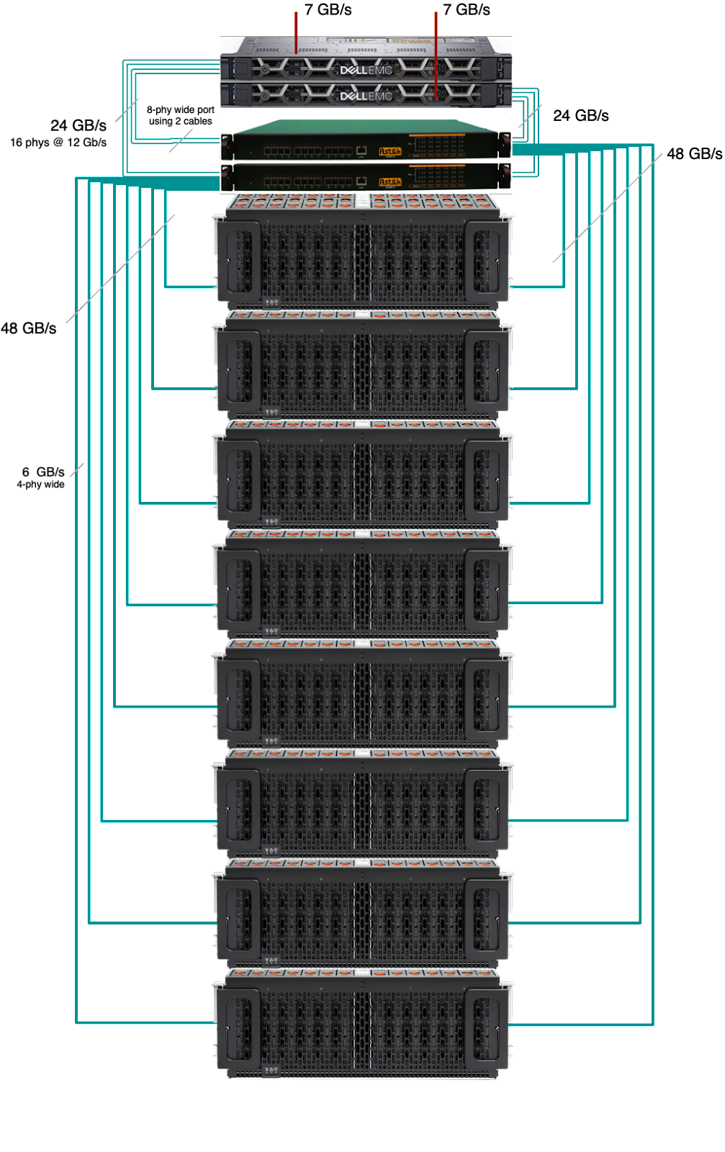
sasutils
sasutils
Display SAS fabric tree and provide aggregated view of devices
sas_discover, sas_devices, sas_counters, ses_report
Based on sysfs (and also sg3_utils and smp_utils)
Support SES Enclosure Nickname
Open source, available at https://github.com/stanford-rc/sasutils
Published in EPEL 7, EPEL 8 and soon in EPEL 9
Or use “pip install sasutils”
Notes:
Suite of tools to be able to discover, verify and monitor components of the I/O cells
Two of the tools can be used for monitoring:
sas_counters and ses_report allow for output to be formatted for use with Graphite

Slide 5
sasutils
sas_devices
$ sas_devices
Found 2 SAS hosts
Found 4 SAS expanders
Found 1 enclosure groups
Enclosure group: [io1-jbod1-0][io1-jbod1-1]
NUM VENDOR MODEL REV PATHS
60 x SEAGATE ST8000NM0075 E002 2
Total: 60 block devices in enclosure group
Notes:
Scans SAS devices and resolves associated enclosures.
Useful to quickly check cabling and hardware setup.
With -v, sas_devices will also display all disk devices with serial numbers.

Slide 6
sasutils
sas_devices
sas_discover
$ sas_discover -v
oak-io1-s1
|--host35 SAS9300-8e
| `--8x--expander-35:0 ASTEK
| |--1x--end_device-35:0:0
| | `--enclosure io1-sassw1 ASTEK
| `--4x--expander-35:1 QCT
| |-- 60 x end_device -- disk
| `-- 1 x end_device -- enclosure io1-jbod1-0 QCT
`--host36 SAS9300-8e
`--8x--expander-36:0 ASTEK
|--1x--end_device-36:0:0
| `--enclosure io1-sassw2 ASTEK
`--4x--expander-36:1 QCT
|-- 60 x end_device -- disk
`-- 1 x end_device -- enclosure io1-jbod1-1 QCT
Notes:
Display SAS topology.
By default, sas_discover tries to fold common devices (like disks).
May need to use -v, -vv or -vvv or --addr to display desired level of detail.

Slide 7
sasutils
sas_devices
sas_discover
sas_counters
$ sas_counters
...
oak-io1-s1.SAS9300-8e...Switch184.io1-sassw1.JB4602_SIM_0.io1-jbod1-0.bays.41.ST8000NM0075...ioerr_cnt 2 1487457378
oak-io1-s1.SAS9300-8e...Switch184.io1-sassw1.JB4602_SIM_0.io1-jbod1-0.bays.41.ST8000NM0075...iodone_cnt 7154904 1487457378
oak-io1-s1.SAS9300-8e...Switch184.io1-sassw1.JB4602_SIM_0.io1-jbod1-0.bays.41.ST8000NM0075...iorequest_cnt 7154906 1487457378
...
oak-io1-s1.SAS9300-8e.0x500605b00ab05678.Switch184.io1-sassw2.phys.15.invalid_dword_count 5 1487457378
oak-io1-s1.SAS9300-8e.0x500605b00ab05678.Switch184.io1-sassw2.phys.15.loss_of_dword_sync_count 1 1487457378
oak-io1-s1.SAS9300-8e.0x500605b00ab05678.Switch184.io1-sassw2.phys.15.phy_reset_problem_count 0 1487457378
oak-io1-s1.SAS9300-8e.0x500605b00ab05678.Switch184.io1-sassw2.phys.15.running_disparity_error_count 1 1487457378
...
Notes:
reports I/O and phy error counters and provides SAS topology information
Output supports SES-2 nicknames making it easier to track down issues

Slide 8
sasutils
sas_devices
sas_discover
sas_counters
ses_report
$ ses_report --carbon --prefix=datacenter.stanford
datacenter.stanford.io1-sassw1.Cooling.Left_Fan.speed_rpm 19560 1476486766
datacenter.stanford.io1-sassw1.Cooling.Right_Fan.speed_rpm 19080 1476486766
datacenter.stanford.io1-sassw1.Cooling.Center_Fan.speed_rpm 19490 1476486766
# ses_report --status --prefix=datacenter.stanford | grep SIM
datacenter.stanford.io1-jbod1-0.Enclosure_services_controller_electronics.SIM_00 OK
datacenter.stanford.io1-jbod1-0.Enclosure_services_controller_electronics.SIM_01 OK
datacenter.stanford.io1-jbod1-0.SAS_expander.SAS_Expander_SIM_0 OK
datacenter.stanford.io1-jbod1-0.SAS_expander.SAS_Expander_ISIM_2 OK
datacenter.stanford.io1-jbod1-0.SAS_expander.SAS_Expander_ISIM_0 OK
datacenter.stanford.io1-jbod1-1.Enclosure_services_controller_electronics.SIM_00 OK
datacenter.stanford.io1-jbod1-1.Enclosure_services_controller_electronics.SIM_01 OK
datacenter.stanford.io1-jbod1-1.SAS_expander.SAS_Expander_SIM_1 OK
datacenter.stanford.io1-jbod1-1.SAS_expander.SAS_Expander_ISIM_3 OK
datacenter.stanford.io1-jbod1-1.SAS_expander.SAS_Expander_ISIM_1 OK
Notes:
status and environmental metrics
Obtained through in-band sas to validate hardware status

Slide 9
sasutils
sas_counters
sas_discover
sas_devices
ses_report
udev scripts
sas_sd_snic_alias
sas_mpath_snic_alias
Python library
Listing SAS Hosts, Listing Expanders, Listing Unique Expanders, SCSI Enclosure
Notes:
Udev scripts
Creates aliases for the sata drive ( sdab ) or device mapper ( dm-31 ) locations
All sasutils tools are built using the python libraries that are provided with the suite
Now that we’ve talked about how we use the tools to build the I/O cells, let’s discuss the process of removing older hardware

Slide 10
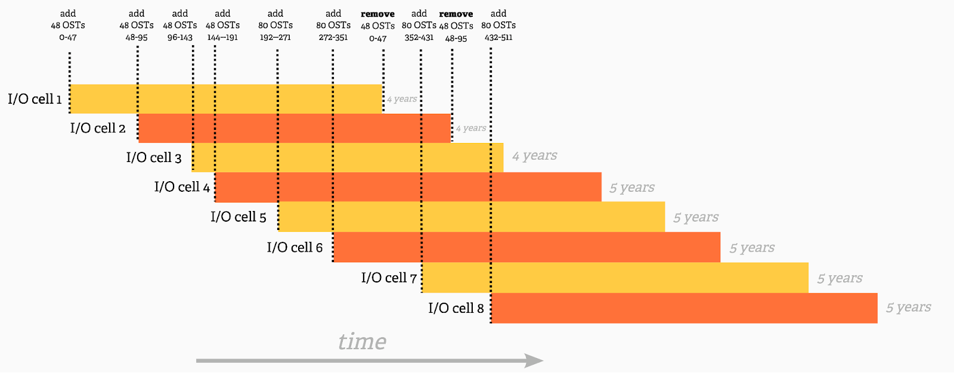
Oak storage lifecycle overview

Slide 11
lctl del_ost
Introduced in Lustre 2.16 (to be release mid-2023)
Documentation is located :
https://build.whamcloud.com/job/lustre-manual/lastSuccessfulBuild/artifact/lustre_manual.xhtml#lustremaint.remove_ost
Notes:
Before del_ost, you had to shut down the filesystem and unmount all clients to be able to permanently remove any OSTs that you want to decommission.
As we showed earlier between Fir and Oak there are more than 450 OSTs, and we couldn't afford a down time every time we needed to remove an OST
This is time consuming and disruptive to the users
This is why we decided to develop del_ost in collaboration with Whamcloud.
With del_ost, you can permanently remove OSTs while leaving the system in production and the changes are transparent to the users.
See the paper for the technical details.
ok, so we’ve talked about tools to help built and removed storage. now I’d like to talk about how things are connected

Slide 12
ibswinfo
Leverages the MFT (Mellanox Firmware Tools )
Normally used for Firmware updates on switches and IB cards
Can also probe the hardware and provide status data
Notes:
- in an academic environment we don't always have the funds for more than the minimum version of hardware
- so, in our environment we use unmanaged IB switches configured in a spine/leaf configuration.
The tool leverages the MFT suite
- normally used for update/verification of firmware
- can also be used to extract hardware and state information from switches.

Slide 13
ibswinfo
# ./ibswinfo.sh -d /dev/mst/<device>
================================
<node description>
================================
part number | MQM8790-HS2F
serial number | <redacted>
product name | Jaguar Unmng IB 200
revision | AC
ports | 40
PSID | MT_0000000063
GUID | <redacted>
firmware version | 27.2000.1886
-------------------------------------------
uptime (d-h:m:s) | 196d-07:05:40
--------------------------------------------
PSU0 status | OK
P/N | MTEF-PSF-AC-C
S/N | <redacted>
DC power | OK
fan status | OK
power (W) | 64
PSU1 status | OK
P/N | MTEF-PSF-AC-C
S/N | <redacted>
DC power | OK
fan status | OK
power (W) | 47
--------------------------------------------
temperature (C) | 34
max temp (C) | 41
--------------------------------------------
fan status | OK
fan#1 (rpm) | 5426
fan#2 (rpm) | 4746
fan#3 (rpm) | 5426
fan#4 (rpm) | 4798
fan#5 (rpm) | 5426
fan#6 (rpm) | 4815
fan#7 (rpm) | 5382
fan#8 (rpm) | 4868
fan#9 (rpm) | 5471
--------------------------------------------
Notes:
The last tool I’d like to discuss is related to GPUs

Slide 14
Slurm SPANK GPU Plugin
Slurm Plug-in Architecture for Node and job (K)control - SPANK
Written in Lua
Requires that the slurm-spank-lua plugin is installed
Flag:
--gpu_cmode=[ shared | exclusive | prohibited ]
Notes:
GPUs are being used more and more
Modes:
Shared: allows more than one compute process per GPU
Exclusive: allows ONLY one compute process per GPU
Prohibited: no COMPUTE processes allowed on the GPU
Exclusive mode is set bu the plugin as the default on Sherlock
Because Exclusive mode is considered to have optimal performance by providing process isolation
However, some legacy applications require Shared mode to be able to run.
Our plugin is a way to give the users more control over the GPU modes by setting the flag in their job submission script

Slide 15
Conclusion
sasutils: https://github.com/stanford-rc/sasutils
ibswinfo: https://github.com/stanford-rc/ibswinfo
Slurm SPANK GPU Plugin: https://github.com/stanford-rc/slurm-spank-gpu_cmode
Notes:
the tools we discussed aim to make our daily sysadmin jobs easier
and sharing them with the community gives us the opportunity to make them better,
based on input from people that use the tools.
If you end up using any of the tools discussed here, I encourage you to leave feed back based on your environment/use case.
You could tell them "Please contribute too! Yay open source!”

